Slide 1
26
Leasing

Slide 2

Chapter 26 – Index of Sample Problems
Slide # 02 - 07 Net advantage to leasing (NAL) - SL
Slide # 08 - 12 Break-even lease payment – SL
Slide # 13 - 14 NAL – No tax – SL
Slide # 15 - 16 NAL – with salvage value – SL
Slide # 17 - 20 NAL – MACRS

Slide 3
2: Net advantage to leasing
(NAL) - SL
Your firm is considering buying a piece of equipment costing $85,000. This equipment has a 3-year life after which time it is worthless. You can borrow money at 9%. Your tax rate is 35%. You will use straight-line depreciation. Your other option is to lease the equipment for $32,000 a year.
What is the amount of the after-tax lease payment?

Slide 4
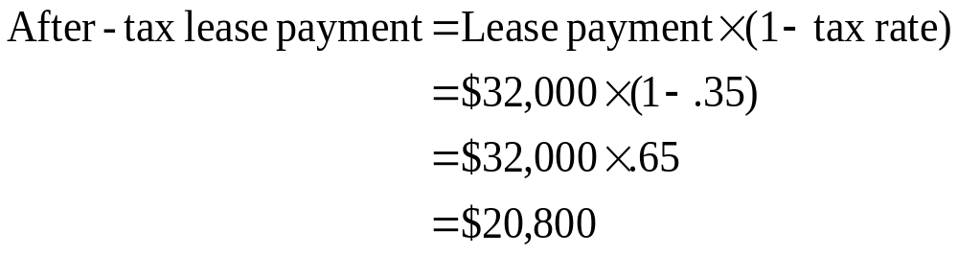
3: Net advantage to leasing
(NAL) - SL
Your firm is considering buying a piece of equipment costing $85,000. This equipment has a 3-year life after which time it is worthless. You can borrow money at 9%. Your tax rate is 35%. You will use straight-line depreciation. Your other option is to lease the equipment for $32,000 a year.

Slide 5
4: Net advantage to leasing
(NAL) - SL
Your firm is considering buying a piece of equipment costing $85,000. This equipment has a 3-year life after which time it is worthless. You can borrow money at 9%. Your tax rate is 35%. You will use straight-line depreciation. Your other option is to lease the equipment for $32,000 a year.
What is the amount of the depreciation tax shield?

Slide 6
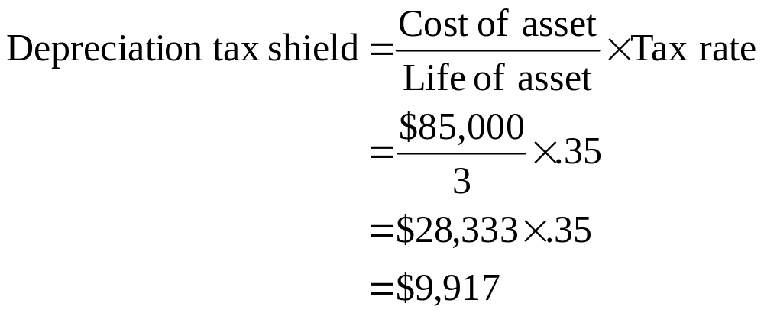
5: Net advantage to leasing
(NAL) - SL
Your firm is considering buying a piece of equipment costing $85,000. This equipment has a 3-year life after which time it is worthless. You can borrow money at 9%. Your tax rate is 35%. You will use straight-line depreciation. Your other option is to lease the equipment for $32,000 a year.

Slide 7
6: Net advantage to leasing
(NAL) - SL
Your firm is considering buying a piece of equipment costing $85,000. This equipment has a 3-year life after which time it is worthless. You can borrow money at 9%. Your tax rate is 35%. You will use straight-line depreciation. Your other option is to lease the equipment for $32,000 a year.
What is the net advantage to leasing?

Slide 8
7: Net advantage to leasing
(NAL) - SL
 | Year 0 | Year 1 | Year 2 | Year 3
ATLP |  | -20,800 | -20,800 | -20,800
LDTS |  | -9,917 | -9,917 | -9,917
Cost | +85,000
Total cash flow | +85,000 | -30,717 | -30,717 | -30,717
Discount rate = 9% × (1-.35) = 5.85%
NAL = NPV = $2,665
ATLP: After-tax lease payment
LDTS: Lost depreciation tax shield

Slide 9
8: Break-even lease payment - SL
Your firm is considering buying a piece of equipment costing $85,000. This equipment has a 3-year life after which time it is worthless. You can borrow money at 9%. Your tax rate is 35%. You will use straight-line depreciation. Your other option is to lease the equipment for $32,000 a year.
What is the amount of the break-even lease payment?

Slide 10
9: Break-even lease payment - SL
 | Year 0 | Year 1 | Year 2 | Year 3
ATLP
LDTS |  | -9,917 | -9,917 | -9,917
Cost | +85,000
Total cash flow | +85,000 | ? | ? | ?
Discount rate = 9% × (1-.35) = 5.85%
NAL = NPV = $0
ATLP: After-tax lease payment
LDTS: Lost depreciation tax shield

Slide 11
10: Break-even lease payment - SL
 | Year 0 | Year 1 | Year 2 | Year 3
ATLP |  | ? | ? | ?
LDTS |  | -9,917 | -9,917 | -9,917
Cost | +85,000
Total cash flow | +85,000 | -31,711 | -31,711 | -31,711
Discount rate = 9% × (1-.35) = 5.85%
NAL = NPV = $0
ATLP: After-tax lease payment
LDTS: Lost depreciation tax shield

Slide 12
11: Break-even lease payment - SL
 | Year 0 | Year 1 | Year 2 | Year 3
ATLP |  | -21,794 | -21,794 | -21,794
LDTS |  | -9,917 | -9,917 | -9,917
Cost | +85,000
Total cash flow | +85,000 | -31,711 | -31,711 | -31,711
ATLP: After-tax lease payment
LDTS: Lost depreciation tax shield

Slide 13
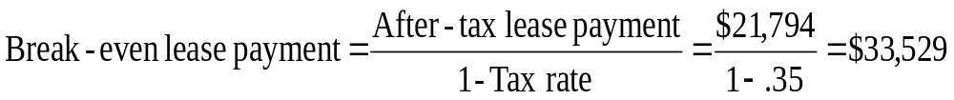
12: Break-even lease payment - SL
 | Year 0 | Year 1 | Year 2 | Year 3
ATLP |  | -21,794 | -21,794 | -21,794
LDTS |  | -9,917 | -9,917 | -9,917
Cost | +85,000
Total cash flow | +85,000 | -31,711 | -31,711 | -31,711
ATLP: After-tax lease payment
LDTS: Lost depreciation tax shield

Slide 14
13: NAL – No tax - SL
Your firm is considering buying a piece of equipment costing $85,000. This equipment has a 3-year life after which time it is worthless. You can borrow money at 9%. You will use straight-line depreciation. Your other option is to lease the equipment for $32,000 a year.
What is the net advantage to leasing if your firm does not expect to pay any taxes for the next three years?

Slide 15
14: NAL – No tax - SL
 | Year 0 | Year 1 | Year 2 | Year 3
ATLP |  | -32,000 | -32,000 | -32,000
LDTS |  | 0 | 0 | 0
Cost | +85,000
Total cash flow | +85,000 | -32,000 | -32,000 | -32,000
Discount rate = 9% × (1 - .0) = 9%
NAL = NPV = $3,999
ATLP: After-tax lease payment
LDTS: Lost depreciation tax shield

Slide 16
15: NAL – With salvage value - SL
Your firm is considering buying a piece of equipment costing $85,000. This equipment has a 3-year life. You can borrow money at 9%. Your tax rate is 35%. You will use straight-line depreciation. Your other option is to lease the equipment for $32,000 a year.
What is the net advantage to leasing if the equipment can be sold for $6,000 (pre-tax) at the end of the three years?

Slide 17
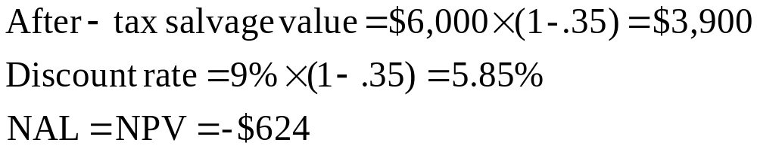
16: NAL – With salvage value - SL
 | Year 0 | Year 1 | Year 2 | Year 3
ATLP |  | -20,800 | -20,800 | -20,800
LDTS |  | -9,917 | -9,917 | -9,917
Cost | +85,000
Salvage |  |  |  | -3,900
Total cash flow | +85,000 | -30,717 | -30,717 | -34,617
ATLP: After-tax lease payment
LDTS: Lost depreciation tax shield

Slide 18
17: NAL - MACRS
You are debating whether you should lease or buy a piece of equipment which costs $50,000. The equipment can be used for 4 years after which time it will be worthless. If you buy it, the equipment will be depreciated using the 3-year MACRS depreciation schedule of 33.33% in year 1, 44.44% in year 2, 14.82% in year 3 and 7.41% in year 4. Your cost of debt is 7% and your tax rate is 34%. You can lease the equipment for $14,000 a year for four years.
What is the net advantage to leasing (NAL)?

Slide 19
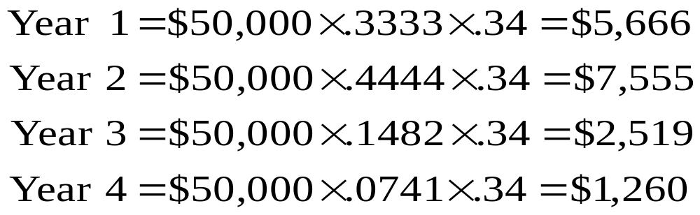
18: NAL - MACRS
Lost depreciation tax shield:

Slide 20
19: NAL – MACRS
 | Year 0 | Year 1 | Year 2 | Year 3 | Year 4
ATLP |  | -9,240 | -9,240 | -9,240 | -9,240
LDTS |  | -5,666 | -7,555 | -2,519 | -1,260
Cost | +50,000
Total cash flow | +50,000 | -14,906 | -16,795 | -11,759 | -10,500
Discount rate = 4.62%
ATLP: After-tax lease payment
LDTS: Lost depreciation tax shield

Slide 21
20: NAL – MACRS
 | Year 0 | Year 1 | Year 2 | Year 3 | Year 4
ATLP |  | -9,240 | -9,240 | -9,240 | -9,240
LDTS |  | -5,666 | -7,555 | -2,519 | -1,260
Cost | +50,000
Total cash flow | +50,000 | -14,906 | -16,795 | -11,759 | -10,500
Discount rate = 4.62%
NAL = NPV = $1,374
ATLP: After-tax lease payment
LDTS: Lost depreciation tax shield

Slide 22
26
End of Chapter 26

